Slide 1
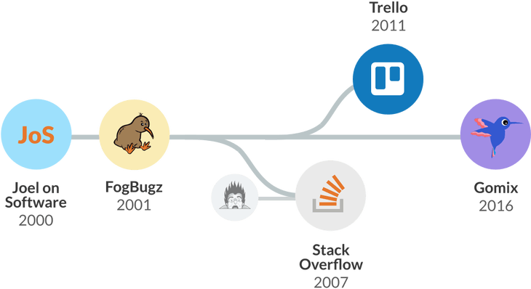
The Joel Test 12 Steps to Better Code
software development
Joel Spolsky
Stack Overflow,

Slide 2
The Joel Test
Do you use source control?
Can you make a build in one step?
Do you make daily builds?
Do you have a bug database?
complete steps to reproduce the bug
expected behavior
observed (buggy) behavior
who it’s assigned to
whether it has been fixed or not

Slide 3
The Joel Test
Do you fix bugs before writing new code?
first version of Microsoft Word for Windows was considered a “death march” project
bug fixing phase was not a part of the formal schedule
The story goes that one programmer, who had to write the code to calculate the height of a line of text, simply wrote “return 12;” and waited for the bug report to come in about how his function is not always correct
Microsoft universally adopted something called a “zero defects methodology”:

Slide 4
The Joel Test
Do you have an up-to-date schedule?
decide what features you are going to do
Do you have a spec?
Do programmers have quiet working conditions?
Do you use the best tools money can buy?
Do you have testers?
Do new candidates write code during their interview?
Do you do “hallway“ usability testing?
user interface design

Slide 5
The Joel Test
A score of 12 is perfect, 11 is tolerable, but 10 or lower and you've got serious problems.
The truth is that most software organizations are running with a score of 2 or 3, and they need serious help, because companies like Microsoft run at 12 full-time
https://www.joelonsoftware.com/2000/08/09/the-joel-test-12-steps-to-better-code/

Slide 6
The Joel Test 12 Steps to Better Code
Programmer Test
John Sonmez is the founder of Simple Programmer and a life coach for software developers
https://simpleprogrammer.com/2015/02/16/joel-test-programmers-simple-programmer-test/

Slide 7
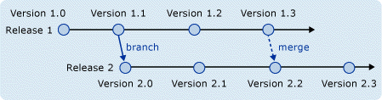
The Joel Test
Can you use source control effectively?
To use source control effectively, you should understand concepts like branching and merging
How to resolve conflicts when merging
How you can use branching or work-spaces to work in isolation or together with teammates
https://msdn.microsoft.com/en-us/library/aa730834(v=vs.80).aspx
Notes:
A component of software configuration management, version control, also known as revision control or source control, is the management of changes to documents, computer programs, large web sites, and other collections of information. Changes are usually identified by a number or letter code, termed the "revision number", "revision level", or simply "revision". For example, an initial set of files is "revision 1". When the first change is made, the resulting set is "revision 2", and so on. Each revision is associated with a timestamp and the person making the change. Revisions can be compared, restored, and with some types of files, merged.

Slide 8
The Joel Test
Can you solve algorithm-type problems?
“Write a function to determine if two words are anagrams of each other.”
solve problems on a whiteboard
Can you program in more than one language or technology?
The best programmers are able to use the best tool for the job.
Do you do something to increase your education or skills every day?
It is impossible to stay relevant if you do not have some kind of habit in place to keep up
Notes:
An anagram is a word or phrase that's formed by rearranging the letters of another word or phrase. “A decimal point” can be turned into the anagram “I'm a dot in place.” The most entertaining anagrams are the ones where the rearranged letters make some sort of comment on the original. “Dormitory” turns into the anagram “dirty room,” and “snooze alarms” can be rearranged into “Alas! No more Zs.”

Slide 9
The Joel Test
Do you name things appropriately?
A good software developer writes clean, and easily understandable code
Can you communicate your ideas effectively?
Do you understand basic design patterns?
Do you know how to debug effectively?
debugging involves starting with a hypothesis of what is wrong and then only using the debugger to prove or disprove that hypothesis

Slide 10
The Joel Test
Do you test your own code?
part of being a good software developer is being a good tester
Do you share your knowledge?
The most valuable person on any team is the person who makes everyone else on the team more valuable, not the person who knows the most
Do you use the best tools for your job?
Can you build an actual application?
Being able to create an entire application—even if it is a small one—shows a fundamental understanding about how software works and how it is constructed

